Slide 1
_{Web applications}
Presented By:
Name: G.Ramash
College Name :The kavery Engineering college
Department :computer science Engineering

Slide 2
Cyber security
Cyber security web applications

Slide 3
Outline
✨ Cyber security web applications Define
✨ applications architecture
✨ request
✨ response
✨ applications
💥Source code.
💥output
✨Conclusion

Slide 4
Cyber Severity web applications Define
Web Applications are integral to almost everything we do, whether it is to access the Internet or to remotely control your lawnmower. In this introduction class we will cover the basics of web application security

Slide 5
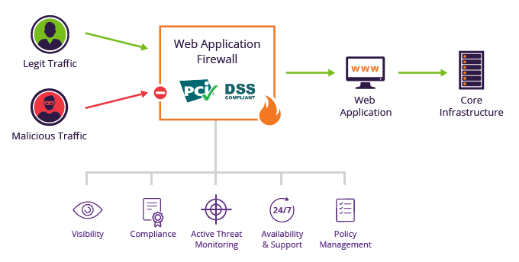
Web applications architecture

Slide 6


Slide 7


Slide 8
The HTTP protocol HTTP is the carrier protocol which allows our browsers and applications to receive content such as HTML ("Hyper Text Markup Language"), CSS ("Cascading Style Sheets"), images and videos.

Slide 9
Protocols
The Scheme is what defined the protocol to use. In our case it is the first part of the URL: https. When the scheme is not defined in the URL it allows the application to decide what to use. Schemes can include an entire array of protocols such as:
HTTP
HTTPS
FTP
SSH
SMB

Slide 10
HTTP REQUEST
Get
Put
Post
Delete
Update
Read
Write

Slide 11
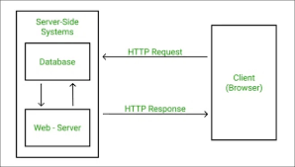
HTTP (Hypertext Transfer Protocol), is the underlying format that is used to structure request and responses for effective communication between a client and a server. The message that is sent by a client to a server is what is known as an HTTP request.

Slide 12
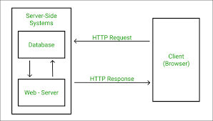
HTTP RESPONSE
An HTTP response has both a header and a body. The header info tells the browser about the protocol being used, whether the request was successful, and what kind of content is included in the body. The body contains the contents (for example, HTML) for the browser to display.

Slide 13
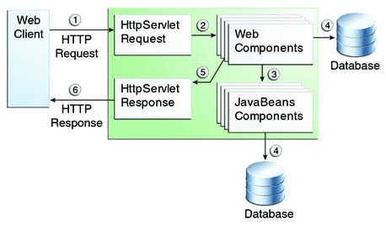
Client to sever

Slide 14
Source code
from flask import Flask, jsonify, request
app = Flask(__name__)
@app.route('/hello', methods=['GET'])
def helloworld():
if(request.method == 'GET'):
data = {"data": "Hello World"}
return jsonify(data)
if __name__ == '__main__':
app.run(debug=True)

Slide 15
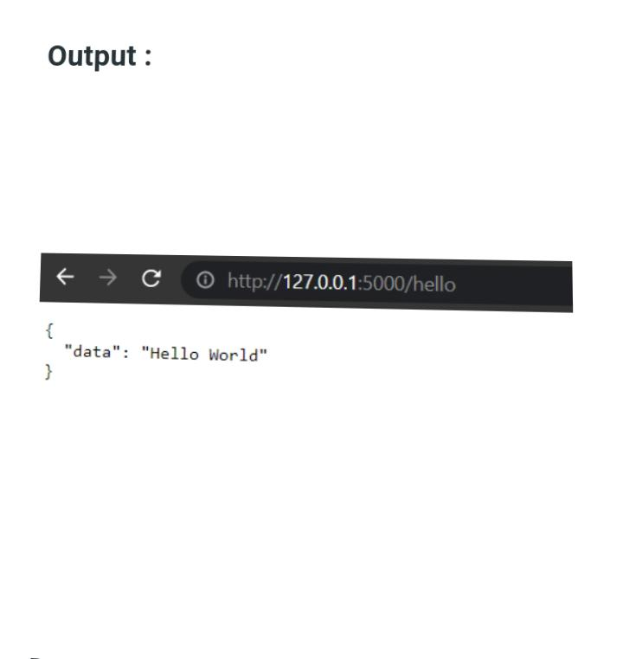
Output

Slide 16
Conclusion:
web application security is a major part of modern organizational risk management. Web applications are more at risk now than ever before, so executives and managers must take the right steps necessary to secure their web applications against new threats.

